Slide 1
Image Restoration AI
Syed Sirajuddin, Ian Rebmann, Carlos Ortiz, Tadbhir Singh
University of San Diego
AAI-521: Applied Computer Vision for AI
Dr. Roozbeh Sadeghian
December 7, 2025

Slide 2

Table Of Contents
Computer Vision Tasks
Colorization
Super Resolution
Inpainting
Denoising
Web Application GUI Demo

Slide 3
Inpainting
Syed Sirajuddin

Slide 4
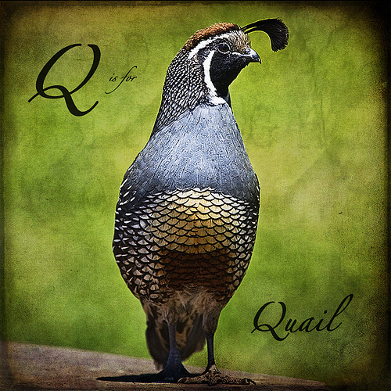
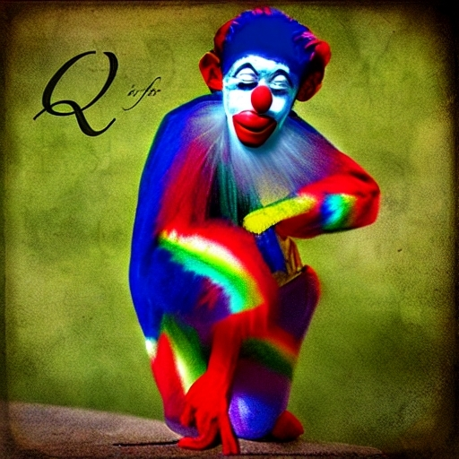
Diffusion-Based Image Inpainting with LoRA Fine-Tuning
Goal: restore missing/damaged regions seamlessly
Prioritized realistic, human-believable results
Secondary goal: reduce hallucinated text/labels/watermarks
Compared:
Base Stable Diffusion v1.5 Inpainting
LoRA-adapted variant

Slide 5
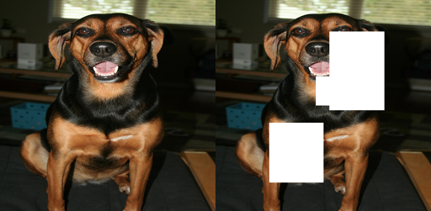
Controlled Damage + Masked Metrics
Dataset structure:
Original / damaged / mask aligned by filename
Resized to 512×512
Synthetic damage regimes:
Small masks: ~0.05–0.15 image size
Large masks: ~0.10–0.40 image size
Metrics:
Masked PSNR & Masked SSIM (primary)
Global PSNR/SSIM (secondary)

Slide 6
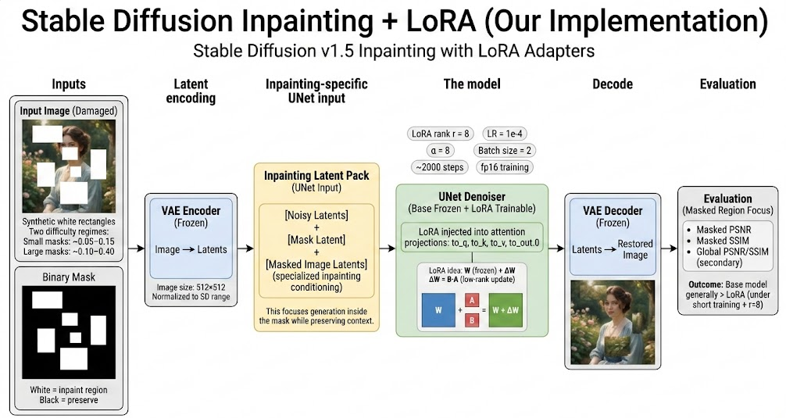
Inpainting Architecture & Training Strategy
Latent diffusion pipeline
VAE encodes image → latents
Text encoder → prompt embeddings
UNet denoises across schedule
Inpainting UNet input is 9-channel
4 noisy latents + 1 mask + 4 masked-image latents
LoRA applied to attention
target modules: to_q, to_k, to_v, to_out.0
VAE + text encoder + base UNet weights frozen

Slide 7
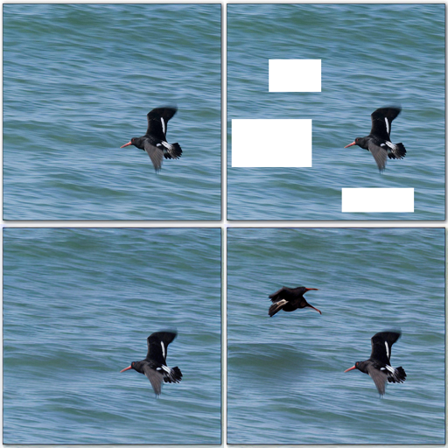
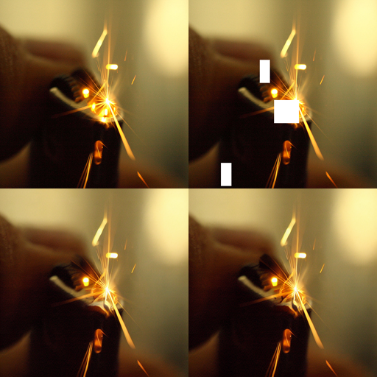
Inpainting: Evaluation and Future Improvements
Small masks
LoRA win-rate: PSNR 32%, SSIM 25%
Base mean masked PSNR 17.998 vs LoRA 17.541
Large masks
LoRA win-rate: PSNR 26%, SSIM 25%
Base mean masked PSNR 13.963 vs LoRA 12.919
Large Masks
Small Masks
Interpretation:
Base model already strong
LoRA likely underpowered for large-region priors
Metrics may understate perceptual quality
Future improvements:
formal train/val/test split
mix small + large + irregular masks
test higher LoRA rank (16–32) + longer training
stratify results by mask area %
Top-left: original | Top-right: damaged | Bottom-left: base | Bottom-right: LoRA

Slide 8
Denoising

Slide 9
Web App GUI (Streamlit Agent Interface)
Purpose: Provide a user-facing demonstration that translates our restoration models into a practical workflow beyond offline notebooks.
Supported Tasks: Denoising, Super-Resolution, Colorization, and Inpainting with task-specific controls shown only when relevant to reduce UI clutter and user error.
Inpainting Capabilities: Mask drawing or mask upload; adjustable brush size/color/opacity; faded-image background for mask legibility; invert-mask option; binary mask preview enforcing the rule: white = fill, black = keep.
Advanced Controls: Prompt and negative prompt, strength (where applicable), guidance scale, inference steps, and seed for controlled base vs LoRA comparisons.
Usability Features: Standard-sized input previews, clear separation of previews vs full-resolution displays, and contextual help messages when masks are not required.
Deployment Value: Demonstrates applied system validation and real-world readiness by linking model outputs to an interactive restoration interface aligned with project rubric expectations.

